Slide 1
Fast Exam Centre.

Slide 2
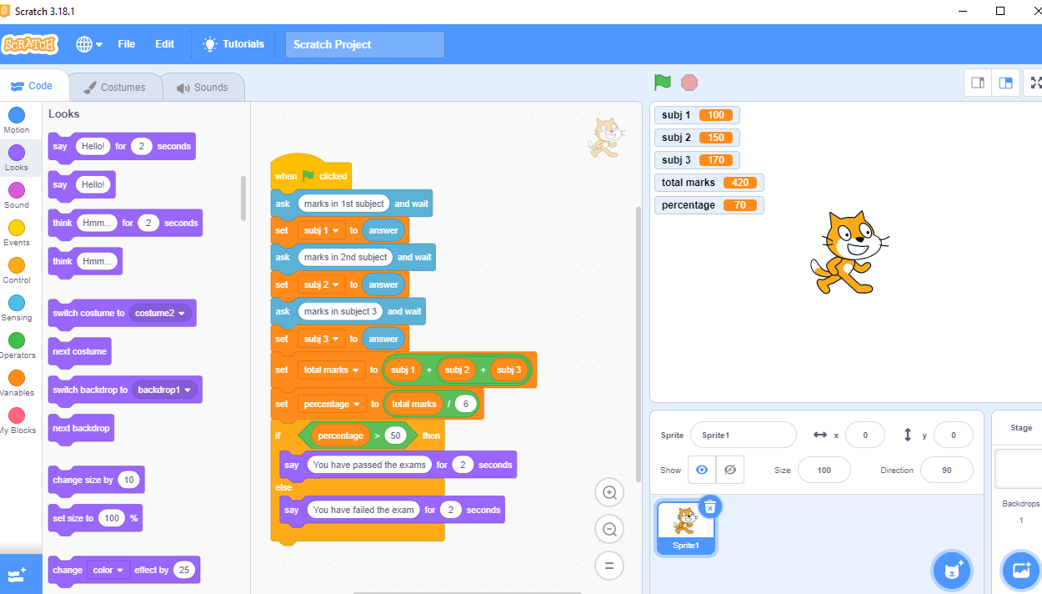
Shah-Latif Town-Karachi, National highway.

Slide 3
21st October 2022

